Slide 1

DATA ANALYSIS AND VISUALISATIONS OF INDIAN PREMIER LEAGUE
Nithin Veer Reddy|Sankaranarayanan|Mohan Dwarampudi

Slide 2
INTRODUCTION
The Indian Premier League is a professional Twenty20 cricket league in India contested during March or April and May of every year by eight teams representing eight different cities in India.In this project we want to present some cool,interesting fun facts ,records and results of IPL.
Given the amount of data collected over the years, this is a perfect scenario to do data analysis, mining. The data is structured which makes it all the more effective to perform data analysis. Due to the abundance of data, it enables us to explore the various aspects of data pipeline as well and how it can scale. This can be used in building a distributed data analysis/mining system.
A huge amount of data indicates that Data Visualizations can also be utilized to generate useful insights. This can also be used as an example of knowledge mining. It can also be used as a feedback mechanism for the players which will help them in improving the performance.
These are some of the use cases.

Slide 3
MILESTONES
Data Extraction from different sources and storing into S3.
Transforming the data into JSON Format.
Creating AWS lambda functions to parse the data before loading into DynamoDB.
Fetching geo data through Google API.
Transformed data is loaded into elasticsearch cluster.
Indexing the incoming data from lambdas with elasticsearch.
Loading the data into three different tables namely Matches,players and Deliverables.
Generate visualisations separately for each of the tables with the created indices using kibana.
Create the dashboards with the already generated visualisations.
Use NGINX to host the created dashboards.

Slide 4
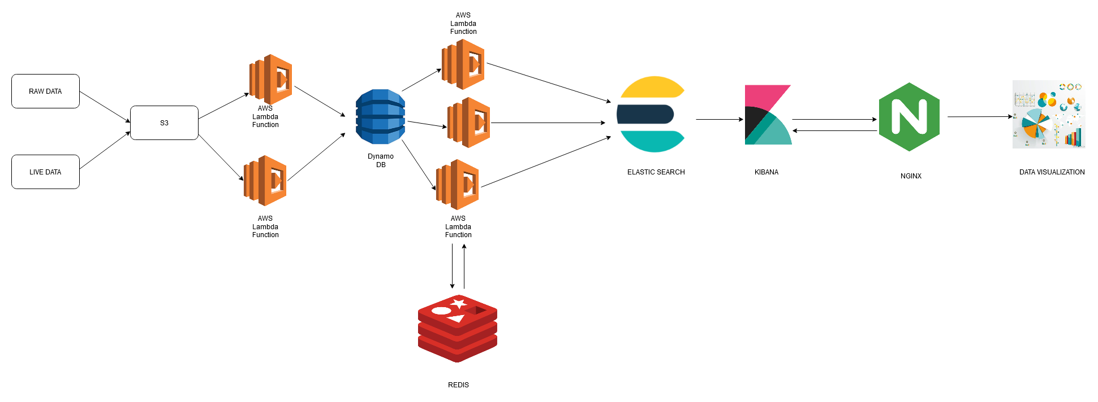
ARCHITECTURE DIAGRAM

Slide 5
WORK PROGRESS AS PER MILESTONES.
In this project we are going to build an end to end ETL pipeline to mine the data to extract valuable insights for better visualisations.
EXTRACT:
We have used the Kaggle dataset → https://www.kaggle.com/manasgarg/ipl.
Using the above Kaggle dataset link we have extracted two csv files namely Matches.csv and Deliveries.csv.
Matches.csv file contains the data related to match such as location,contesting teams,umpires,results etc.
deliveries.csv is the ball-by-ball data of all the IPL matches including data of the batting team, batsman, bowler, non-striker, runs scored, etc.

Slide 6
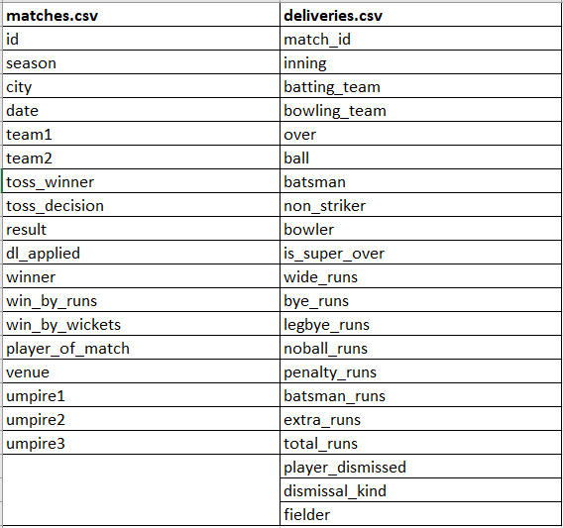
List of attributes present in each input csv files.

Slide 7
We have converted the input csv files into json format.The converted json format is loaded into s3 database.
From the s3 database we have used lambdas to load the data into DynamoDB.
In the DynamoDB we have created two tables namely matches and Deliveries to store the matches and deliveries data.

